Slide 1






PRESENTATION 2026
SEMESTER SMART: Structured Planning for Teachers, Instant Answers for Students
Mentor Name
Faculty Email
Faculty Name
Umamaheshwari R
namo1999d@gmail.com
Namrata Gaur

Slide 2

Outline
Abstract of the Project
Problem Statement
Proposed Solution
System Architecture
Live Demo of the Project
Embedded Video of Project
Conclusion
Future Scope

Slide 3

Abstract
This project, Semester Smart, focuses on organizing academic schedules using a structured Excel dashboard and a rule-based AI chatbot.
The objective is to simplify semester planning and provide quick, accurate academic information to both faculty and students.
Tools used include Microsoft Excel (Pivot Tables, Slicers, Dashboard) and Microsoft Copilot Studio for chatbot development.
The expected outcome is an interactive dashboard for workload visualization and a chatbot that provides instant query resolution.
A key highlight is the integration of data visualization with a rule-based AI assistant, ensuring accuracy, usability, and improved academic planning efficiency.

Slide 4

Problem Statement
Academic data is scattered across multiple sources (Excel sheets, notices, PDFs) and no centralized system for semester planning.
It leads to confusion, inefficiency, poor planning, and lack of timely academic decision-making for students and faculty.
Students (especially first-year confusion) and Teachers (managing multiple academic tasks) and academic administration are majorly affected
Current systems are static, fragmented, and lack integration of data with interactive or AI-based tools.
The project is limited to one semester dataset using Excel dashboard and AI chatbot, without real-time integration or institutional deployment.

Slide 5

Proposed Solution
The proposed solution is a structured academic planning system that combines an interactive Excel dashboard with a rule-based AI chatbot to centralize and simplify semester-related information.
This approach solves the problem of scattered data by organizing all academic events into a single dataset and enabling easy access through visual dashboards and instant chatbot responses.
The methodology includes data collection, cleaning and structuring in Microsoft Excel, analysis using pivot tables and slicers, and chatbot development using Microsoft Copilot Studio with rule-based logic.
The key steps followed were dataset creation, data preprocessing, dashboard design, slicer integration, and chatbot topic and condition building for query handling.
The solution offers improved planning, quick information access, reduced confusion, and stands out by integrating visualization with a controlled, rule-based AI system for accurate and reliable responses.

Slide 6
System Architecture
Data Input / Source
Processing / Analysis
Data source consists of a structured, manually created Excel dataset representing semester-wise academic schedule, events, and workload information.
Data is cleaned by standardizing formats and removing inconsistencies, then transformed using Excel formulas and categorized fields, and analyzed using pivot tables, slicers, and dashboard visualizations
AI / Tool Integration
Output / Dashboard
Excel is used for data structuring, cleaning, and dashboard creation, while an AI chatbot built in Microsoft Copilot Studio is integrated with the dataset to provide instant, query-based academic information.
The final output is an interactive Excel dashboard with charts and KPIs, along with an AI chatbot that provides instant academic information in a user-friendly format .

Slide 7
Live Demo of Project
Here's the list of some demo screenshots / features of the project:
Demo 1
Demo 2
Demo 3
Showcases the Excel-based semester dashboard, highlighting monthly and weekly workload distribution, event categorization, and interactive filtering using pivot tables and slicers to provide a clear overview of academic planning and scheduling
This demo presents an interactive Excel dashboard using slicers for dynamic filtering of academic data. Users can select specific months or subjects to instantly view related events like IA, assignments, and breaks .
This demo presents an interactive Excel dashboard using slicers for dynamic filtering of academic data. Users can select specific months or subjects to instantly view related events like IA, assignments, and breaks.

Slide 8
Video of Project Demo
[https://your-project-demo-link.com]
▶
[Insert your project demo video.
You can embed a video your live project.]

Slide 9

Conclusion
The project “Semester Smart” successfully organized scattered academic data into a structured Excel-based system with an interactive dashboard and AI chatbot.
It enabled clear visualization of semester planning, workload distribution, and academic events.
The chatbot provided instant, user-friendly access to information, improving accessibility for students.
All project objectives, including data cleaning, analysis, visualization, and AI integration, were achieved.
The project demonstrates how simple tools combined with AI can enhance academic efficiency.
Overall, it adds value by promoting data literacy and technology integration in education.
CONCLUSION

Slide 10
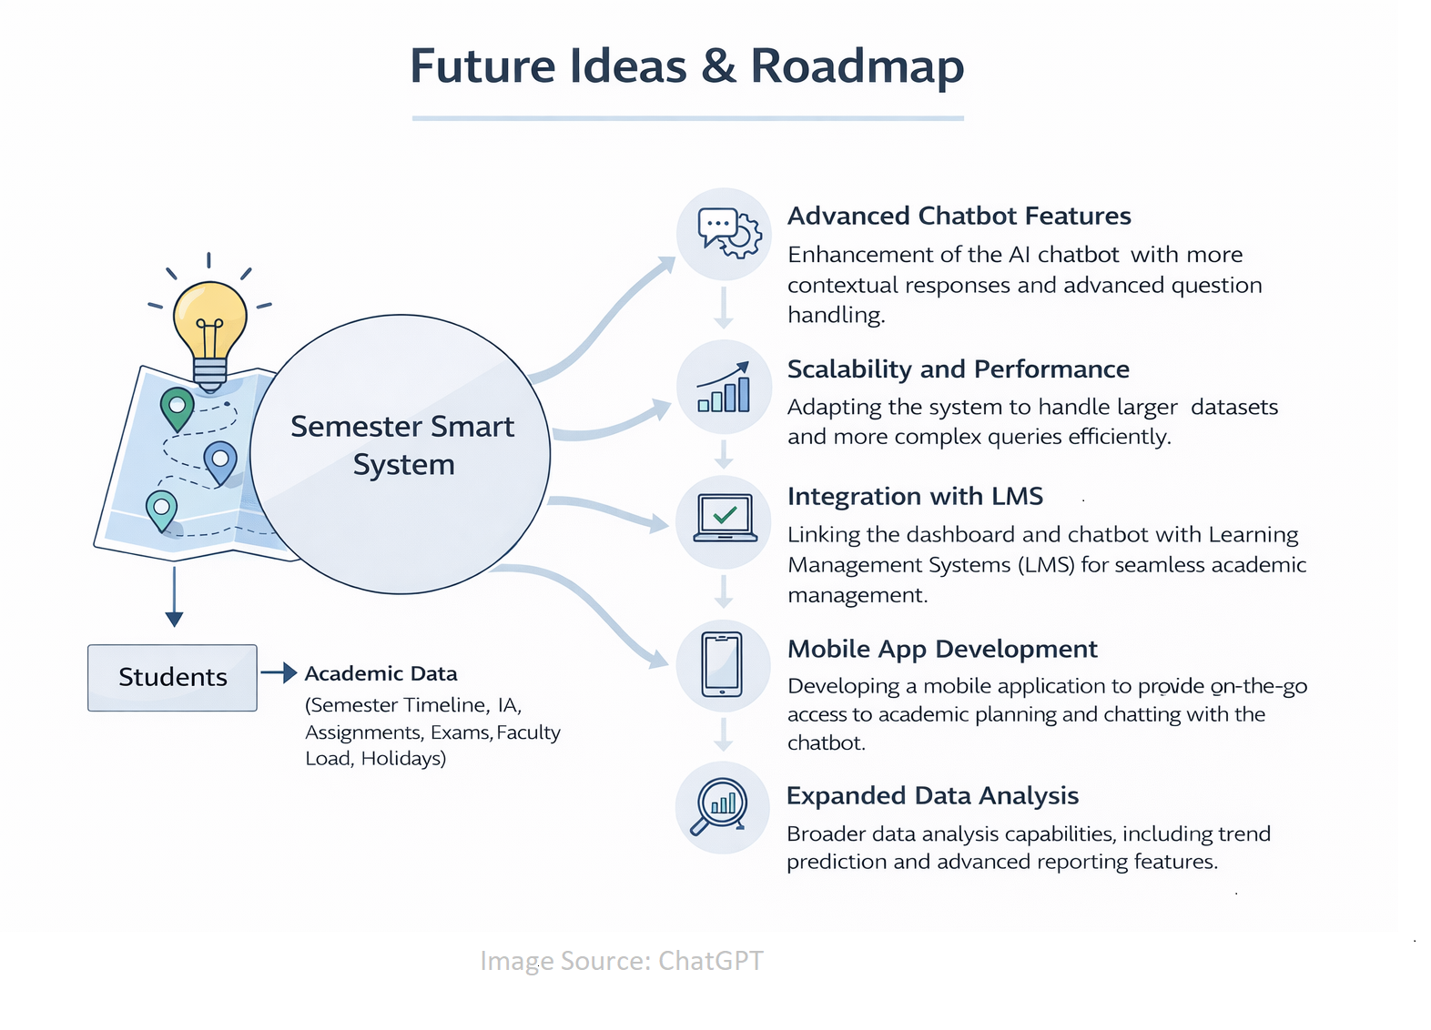

Future Scope
Future enhancements include integrating real-time data from LMS systems to automate updates and reduce manual effort. The project can be scaled across multiple courses, departments, and institutions for broader implementation. The chatbot can be enhanced with more advanced AI capabilities for better natural language understanding. Additional features like alerts, notifications, and personalized student tracking can also be incorporated.

Slide 11
Thank You
AICW Fellowship | Faculty Project Presentation 2026
LinkedIn | Edunet Foundation

